Slide 1
Species and Hybrids

Slide 2
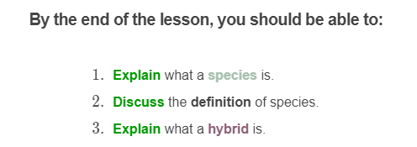
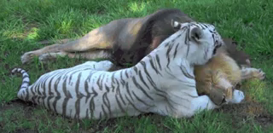

Slide 3
A species is a group of organisms that are capable of reproducing with each other.
For example, a male and a female dog can reproduce and have healthy puppies. They are in the same species.
A male snake and a female crab cannot reproduce and have babies, so they are not in the same species.

Slide 4
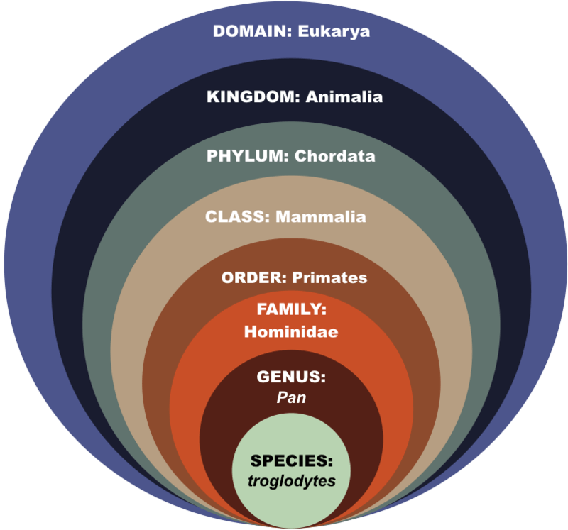
When we look back at our 7 levels of classification, we see that species is the very last group.
Living things of the same species are able to reproduce with each other.
For example, members of the species Pan trogolodytes (the chimpanzee) can only breed with other members of Pan trogolodytes.

Slide 5
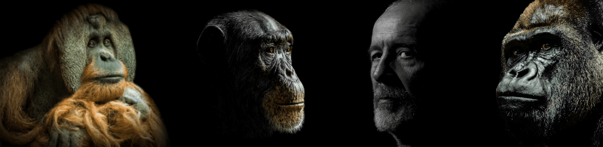
According to Linnaeus' system, a species is the smallest possible grouping of organisms.
Gorillas are a species with the scientific name Gorilla gorilla. Humans are another species, with the scientific name Homo sapiens.
Humans and gorillas are apes, just like chimpanzees and orangutans. They are not the same species!

Slide 6
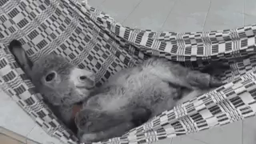
In biology, there are always exceptions to the rule!
Hybrids can be produced when two members of different species interbreed. Hybrids are infertile, so they cannot have offspring (babies) of their own.
For example, a mule is a hybrid. It is produced when a donkey and a horse interbreed. Donkeys and horses are closely related, but are not the same species!

Slide 7
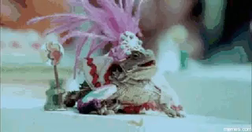
Many plants and microorganisms are asexual organisms.
But did you know that some animals are also asexual? For example, the New Mexico whiptail lizard is a female-only species. Those animals don't need males to reproduce. This particular species originated from a hybrid, a long time ago!

Slide 8
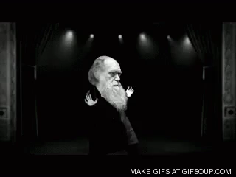
Linnaeus formalized the taxonomic rank of species during the 18th century.
The idea that similar organisms reproduce and give birth to other similar organisms is not new. However, it's not because organisms look alike that they are not changing over time!
In 1859, C. Darwin released his book On the Origin of Species where he explained how species evolve through a gradual process.

Slide 9
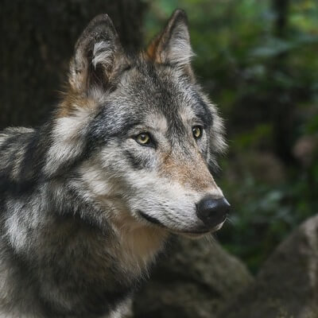
Hybrids are great examples of those blurry boundaries.
Hybrids bend the rules. However, you can't have a hybrid of two extremely different organisms.
Hybrids are born from somewhat related organisms like lions and tigers, or coyotes and wolves.

Slide 10
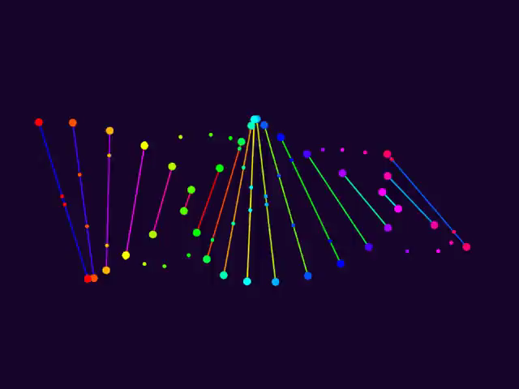
For asexual organisms, scientists can't use sexual reproduction as a way to define species.
Here, a species consists of organisms of common origin, which are more similar to each other than they are to any other organisms.
This definition is based on observable characteristics and genetics. Genes are the elements that determine organisms traits like their eye colour. They are passed down from parents to offspring.

Slide 11
